Slide 1
Week2 (B)

Slide 2


Slide 3
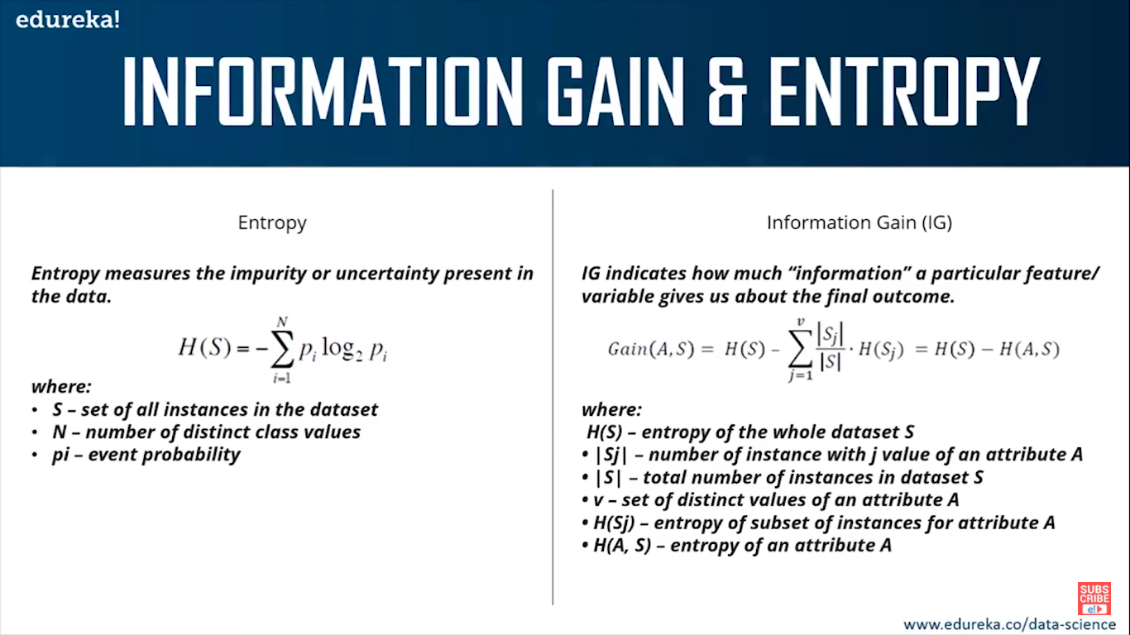

Slide 4
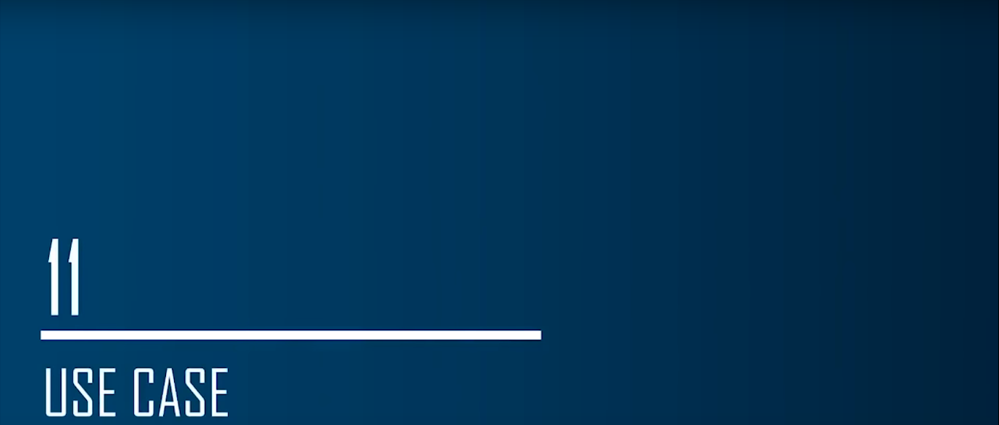

Slide 5
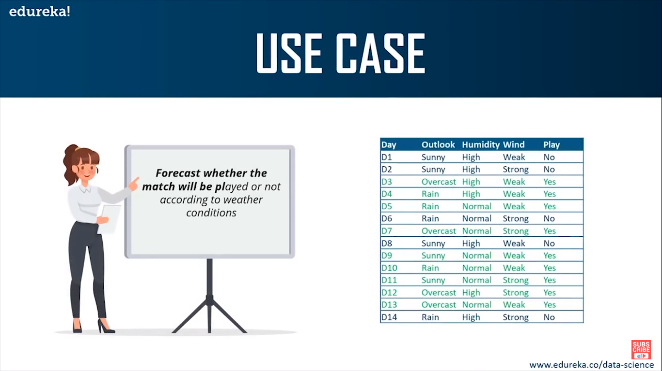

Slide 6
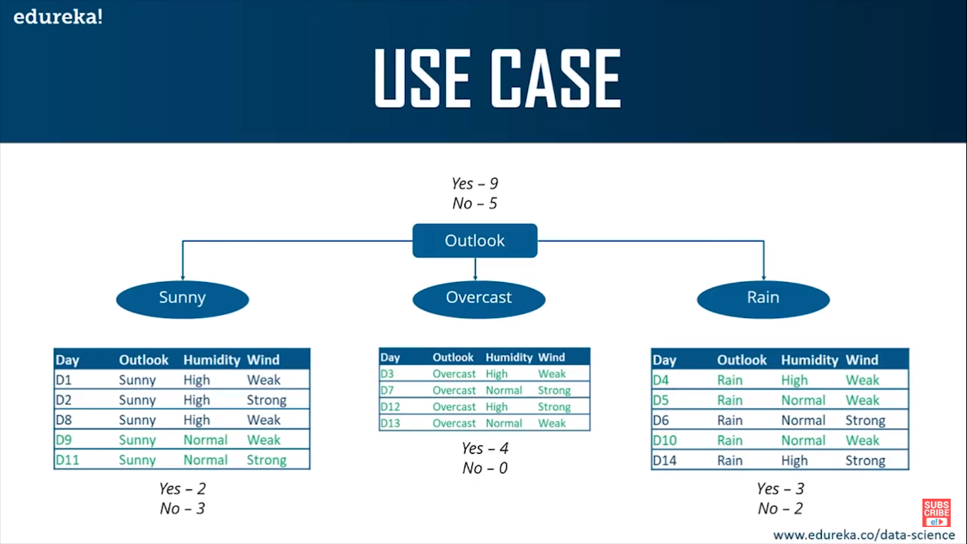

Slide 7
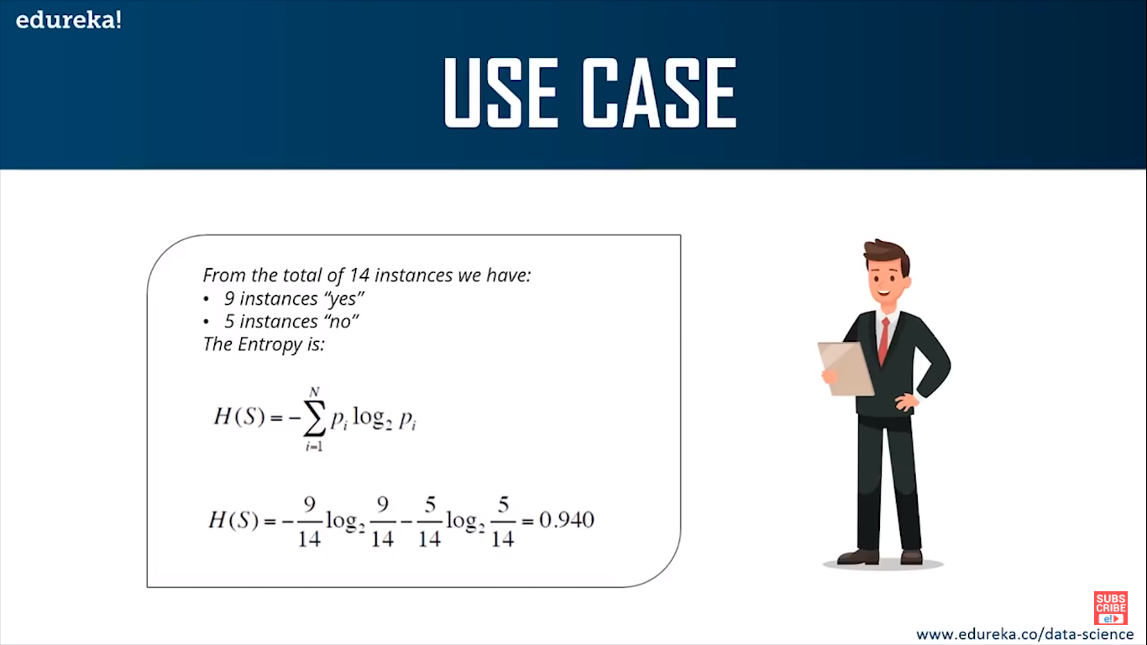

Slide 8
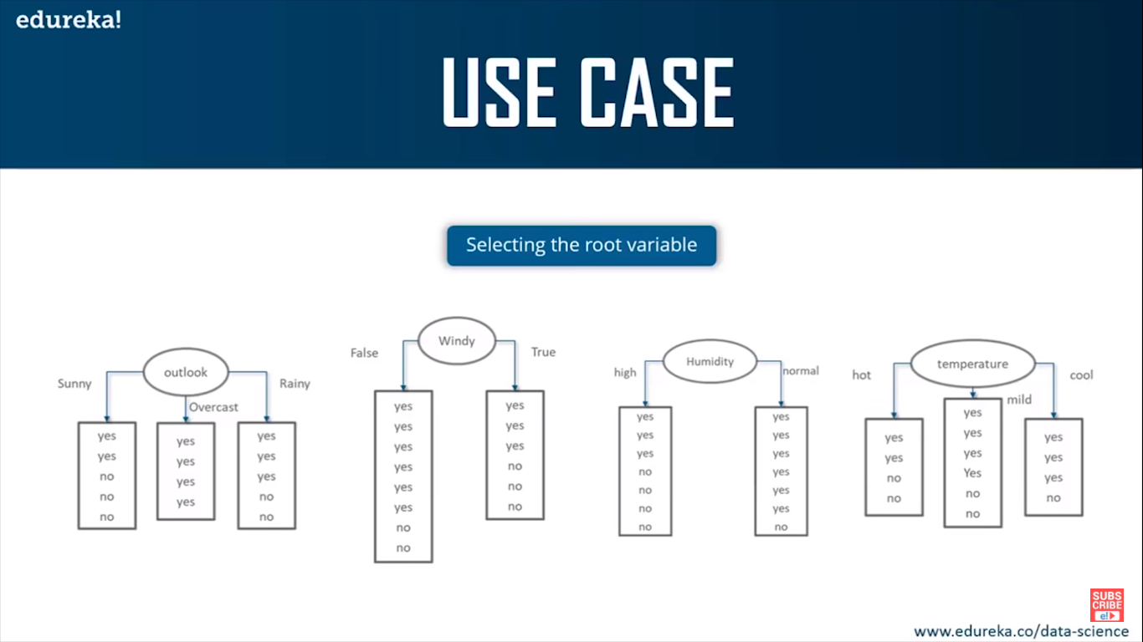

Slide 9
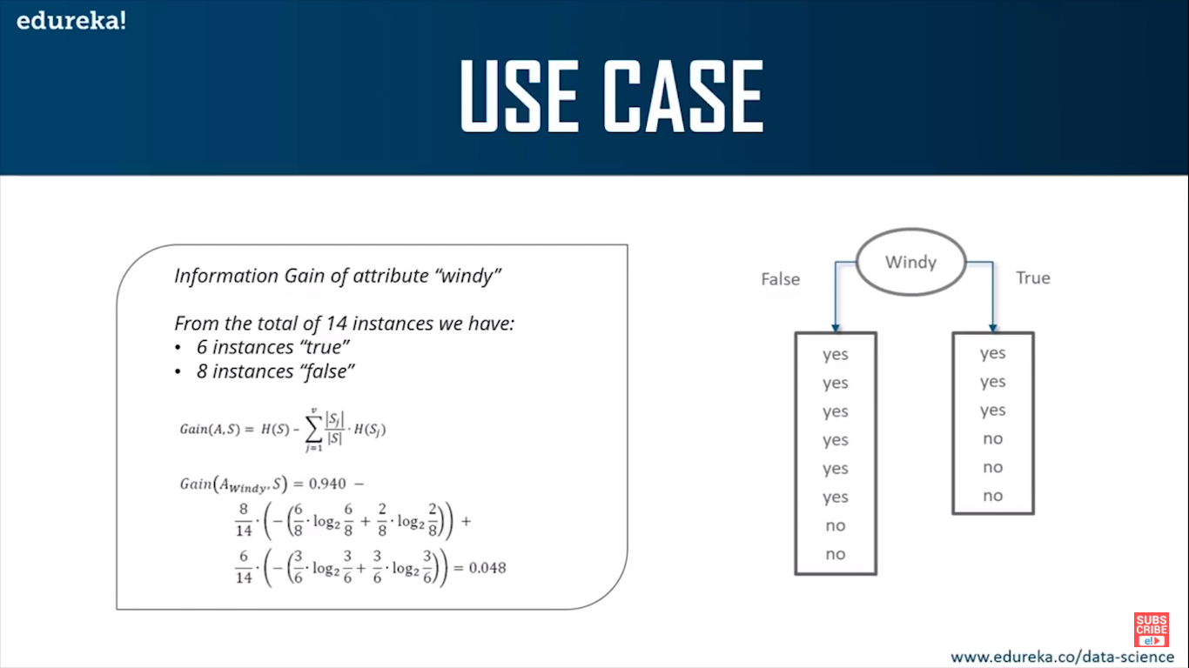

Slide 10
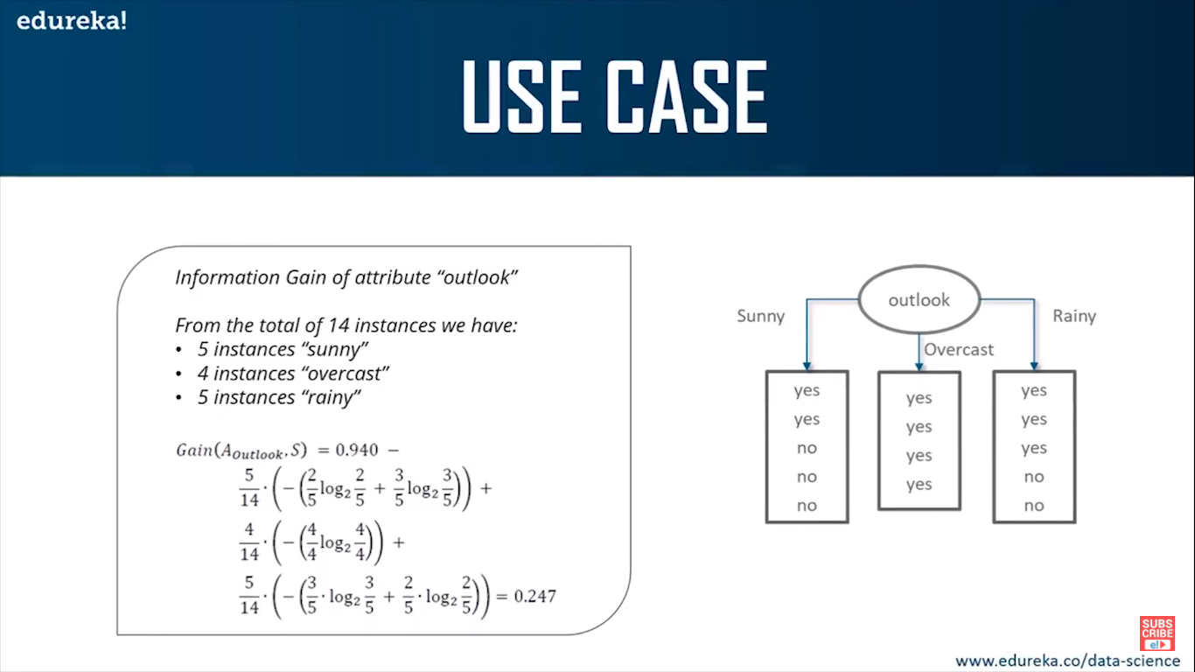

Slide 11
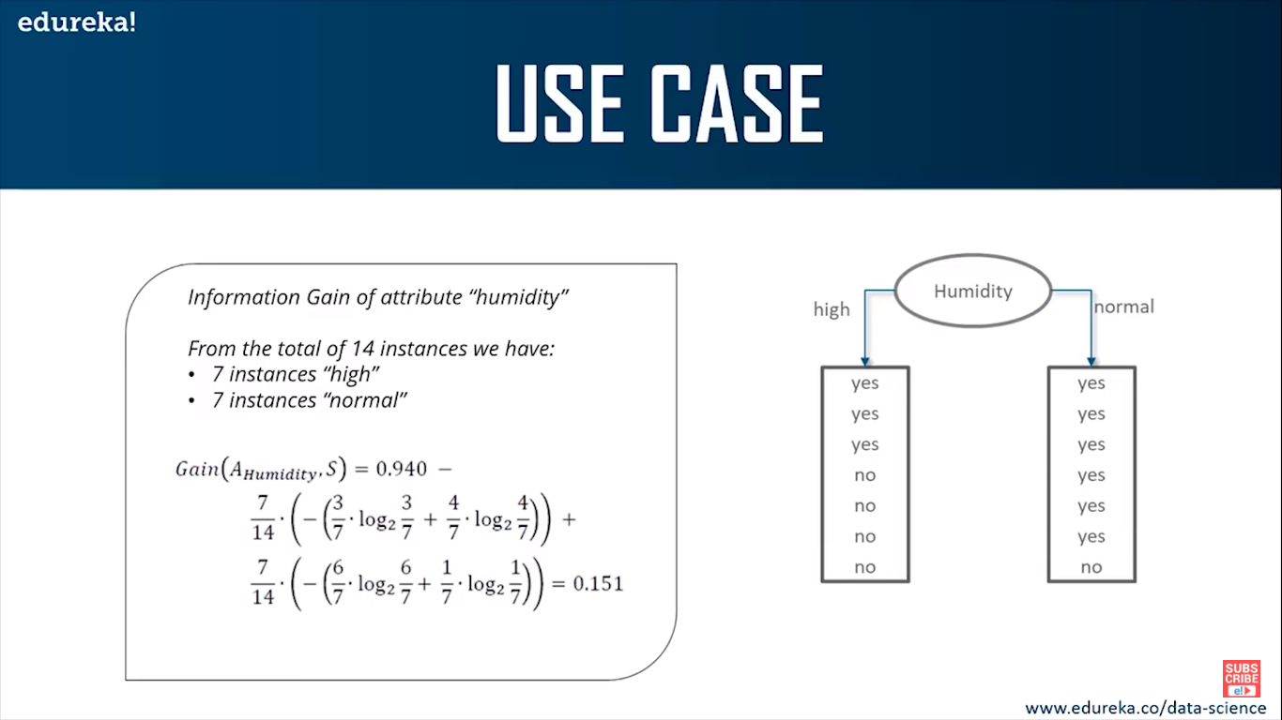

Slide 12
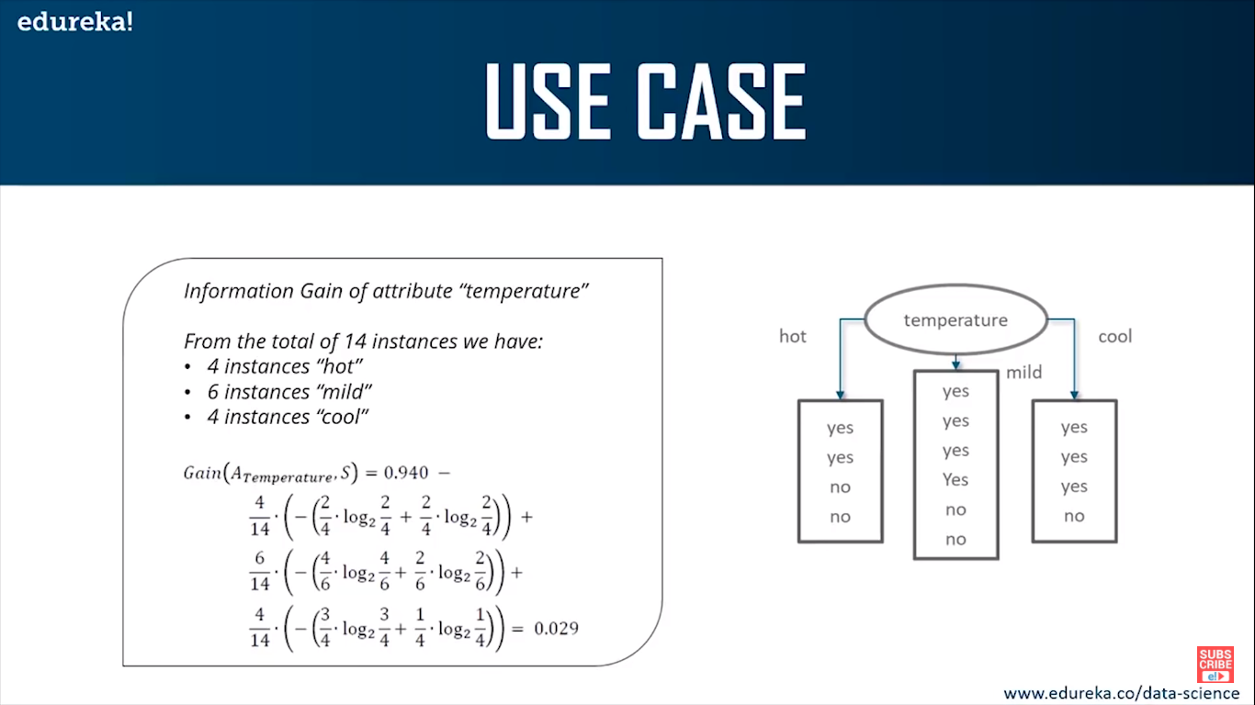

Slide 13
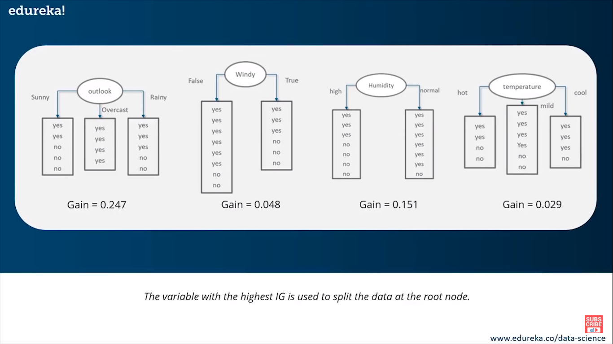

Slide 14
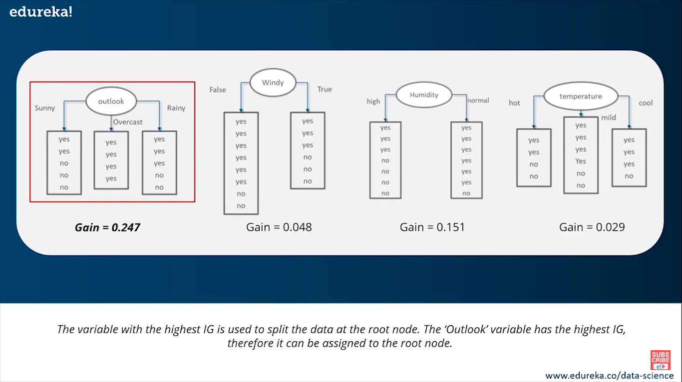

Slide 15
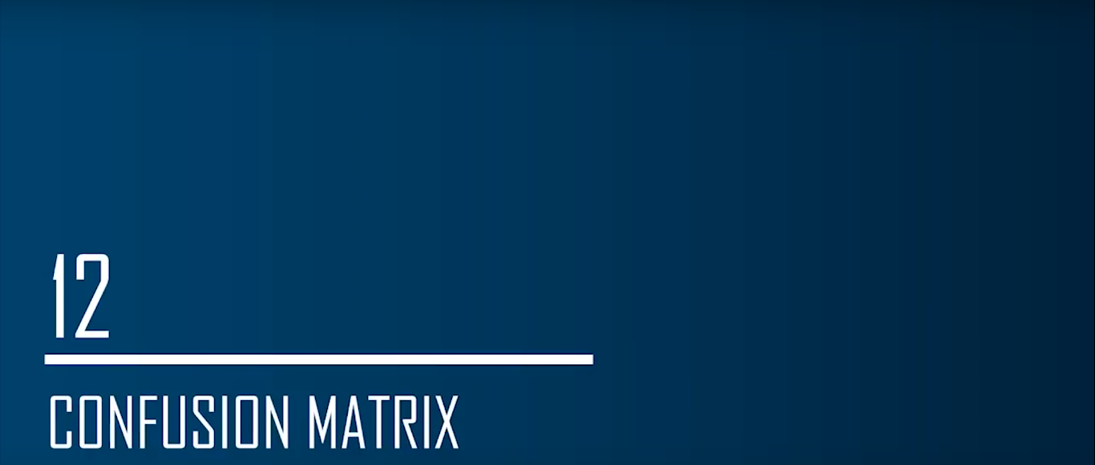

Slide 16
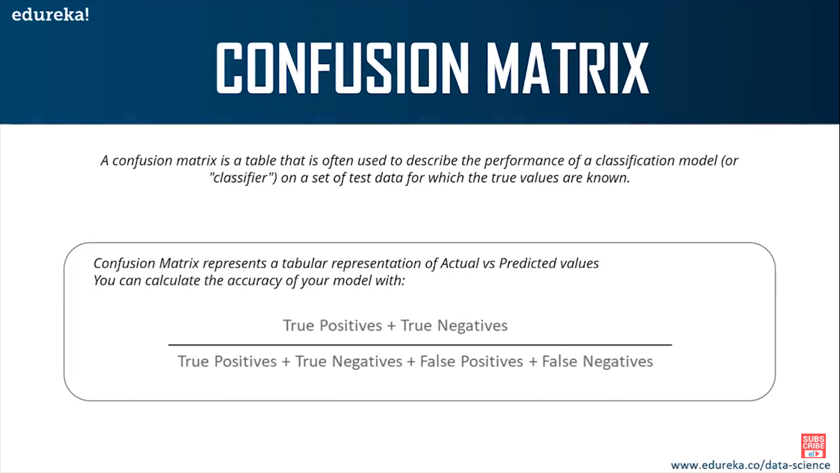

Slide 17
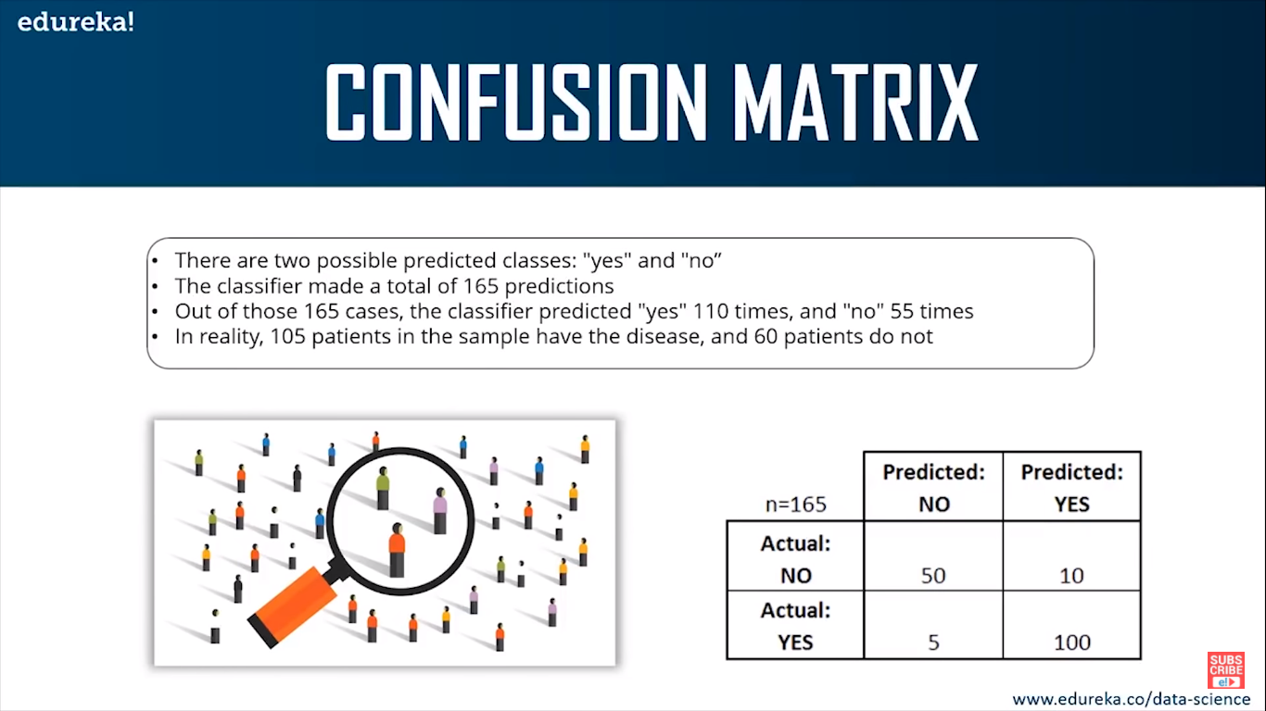

Slide 18
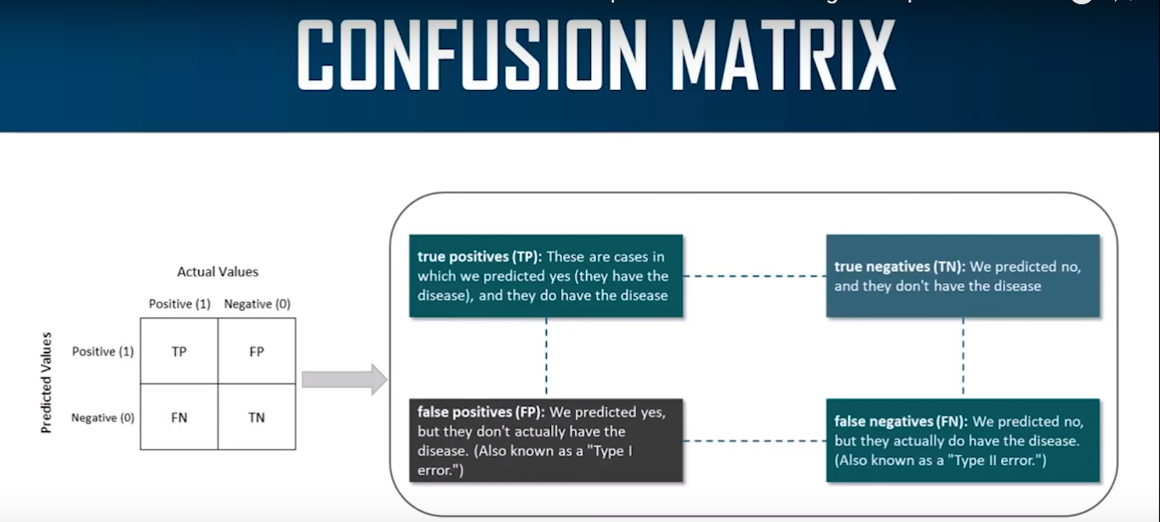

Slide 19
Class Activity01
Problem Identification
Find out problem and Understand it. Identify its requirements and class/labels to be predicted.
Data Collection
Acquire data, there are many data sources, studied in class, collect data from any of those.
Data Preprocessing
Make your data into desired format, find and fill missing values, remove unnecessary data.

Slide 20
Class Activity01 – Cont.
Data Exploration
Do some analysis and visualization for finding out some meaningful patterns from data.
ML Model Selection
Split the data into train and test (80%, 20% ration respectively)
Determine model to be applied on data (whether classification/regression).
Apply some models and find out which model is the best amongst others.
Model Evaluation
Train and test the efficiency of the model.

Slide 21
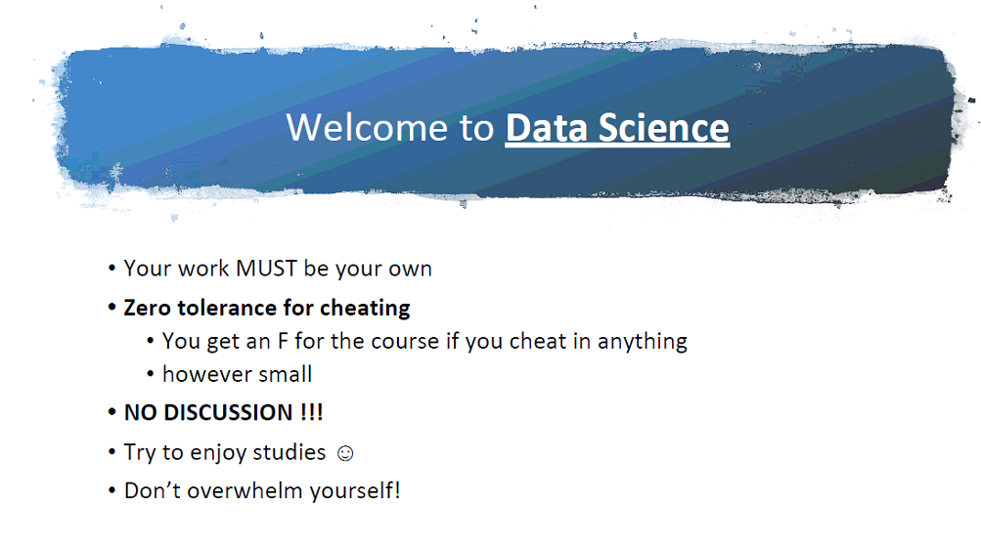

Slide 22
